Slide 1
Bloomberg

Slide 2
Standard layout for a specific article

Slide 3
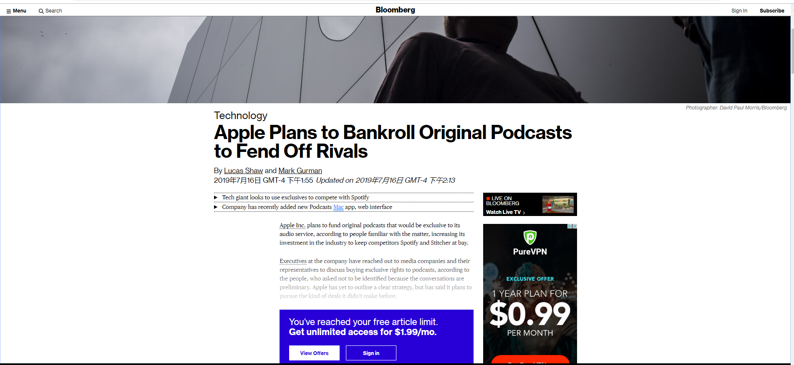
https://www.bloomberg.com/news/articles/2019-07-16/apple-plans-to-bankroll-original-podcasts-to-fend-off-rivals

Slide 4
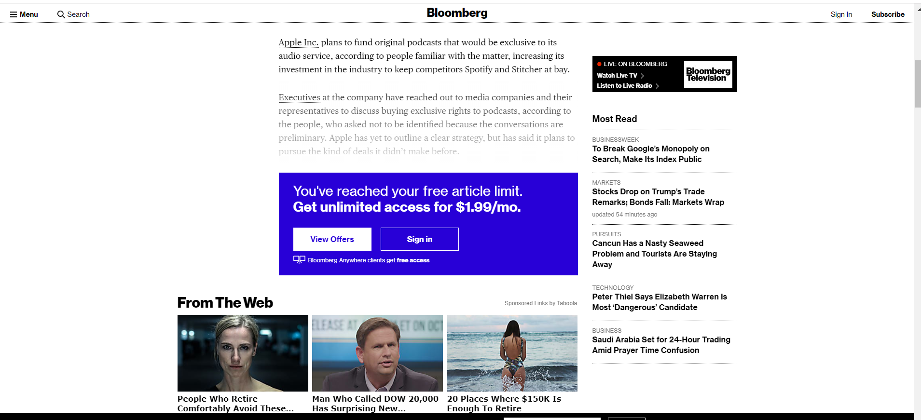

Slide 5
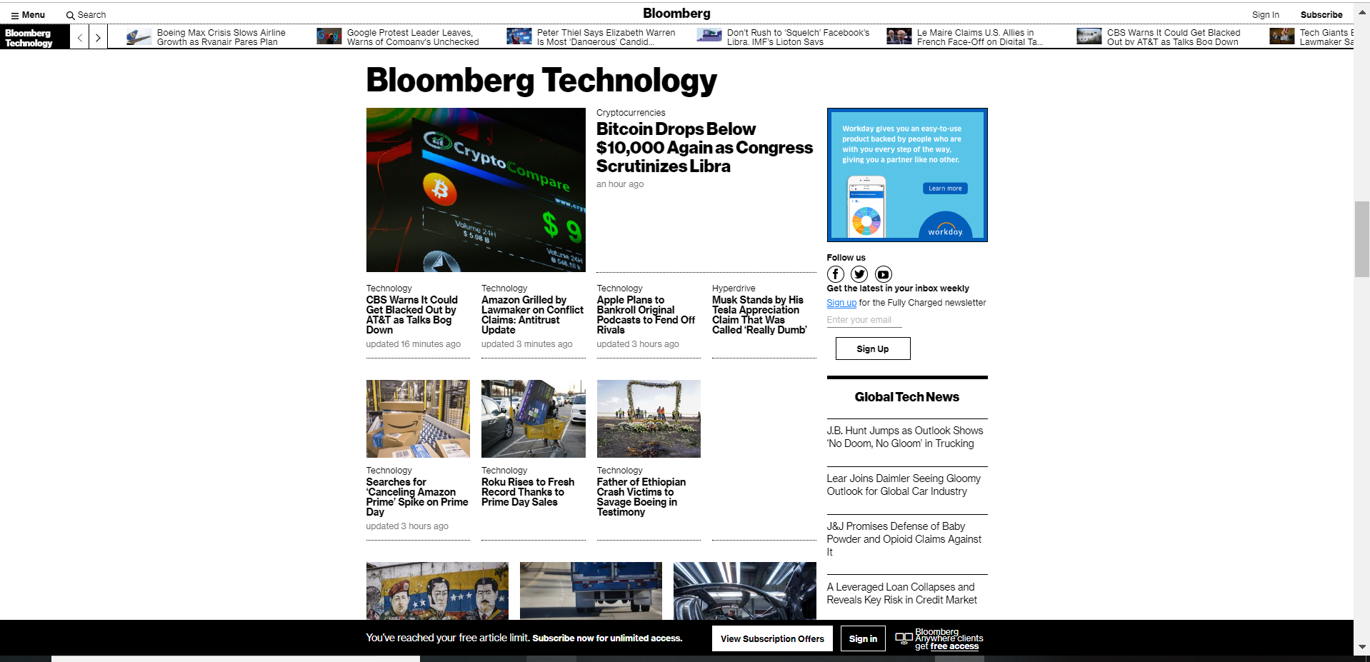

Slide 6
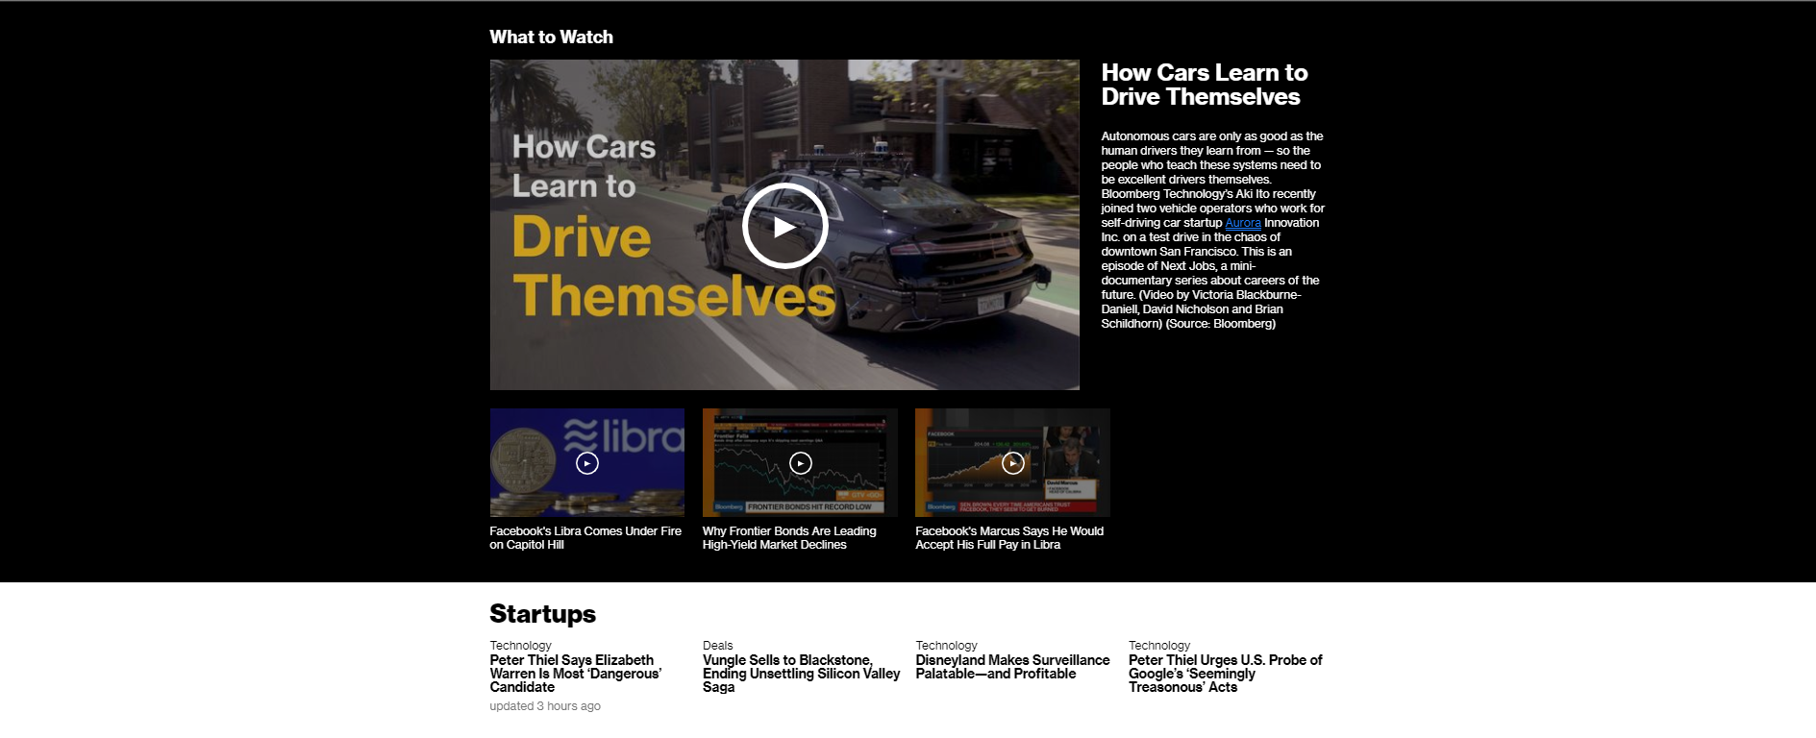
increase readability！

Slide 7
Homepage layout——something different

Slide 8
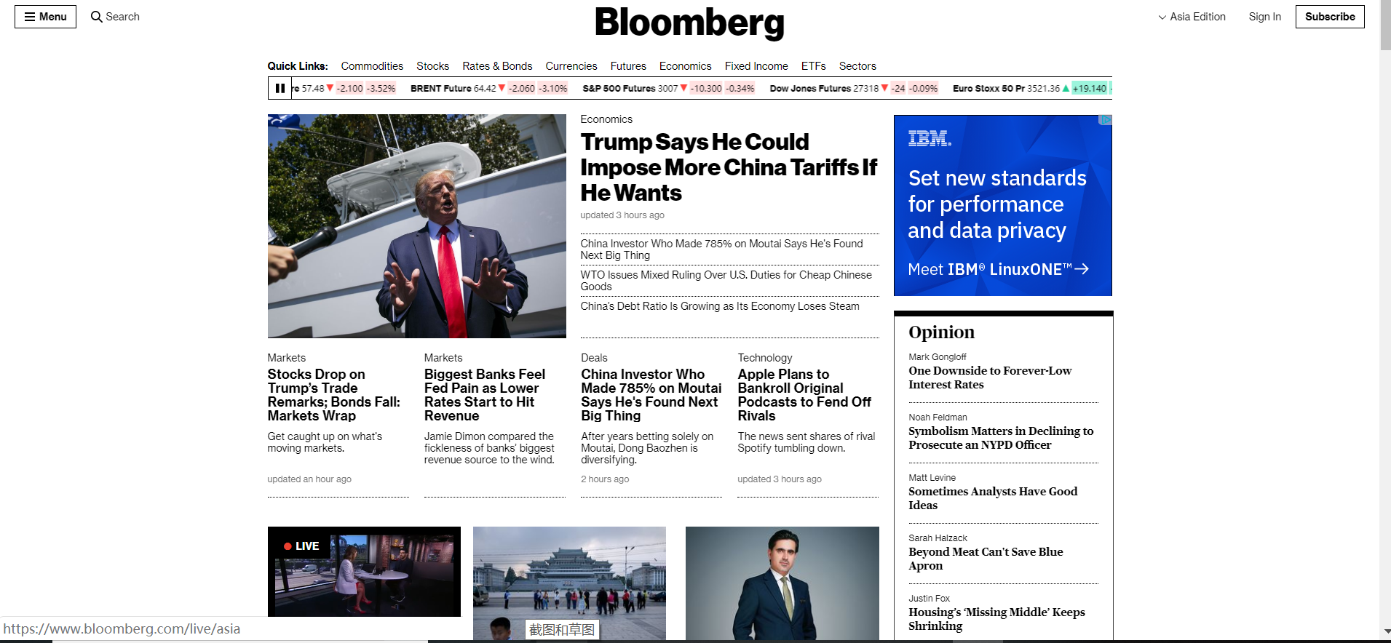
https://www.bloomberg.com/asia

Slide 9
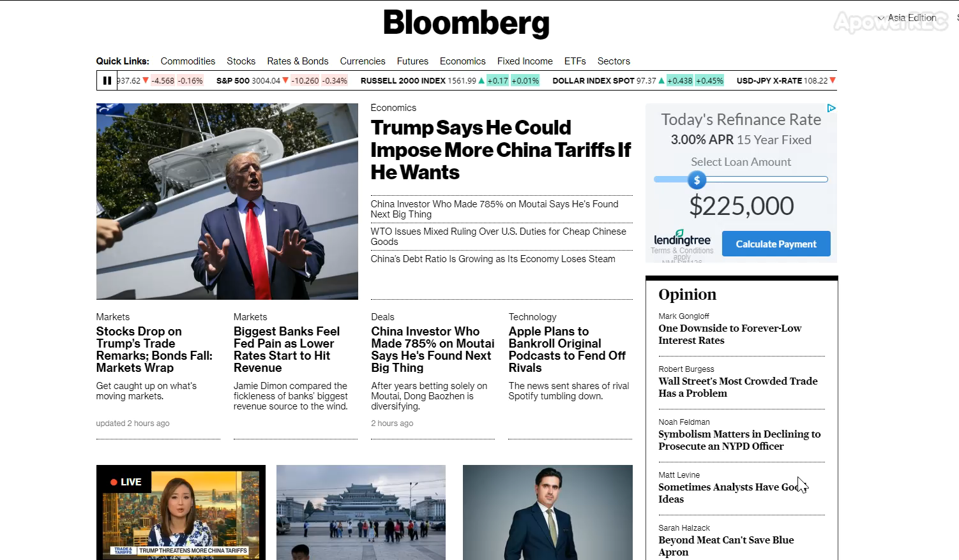

Stock index scroll bar

Slide 10
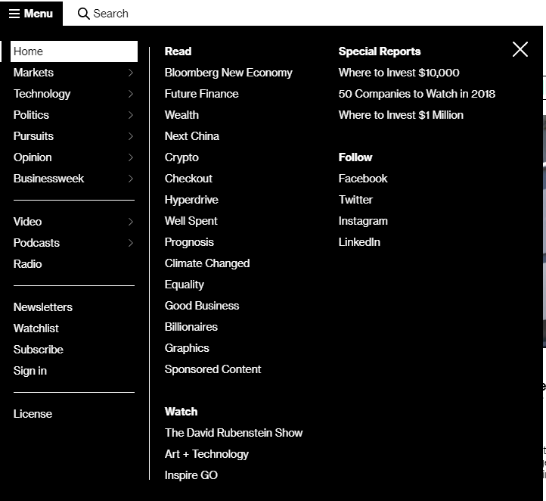

Menu

Slide 11
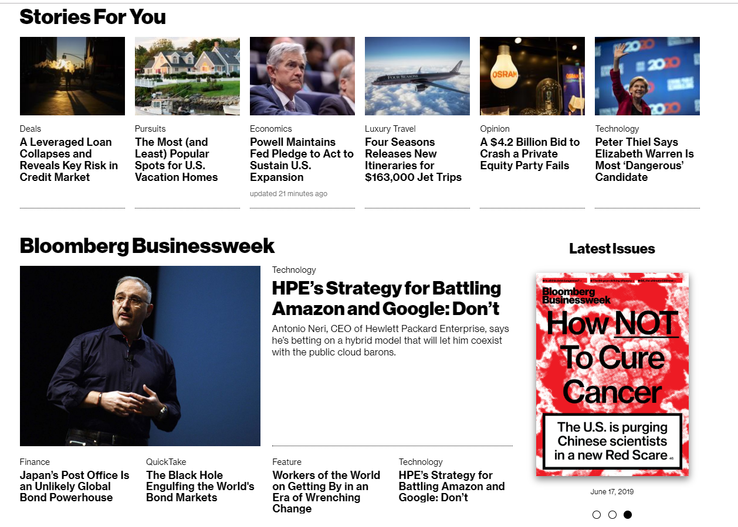
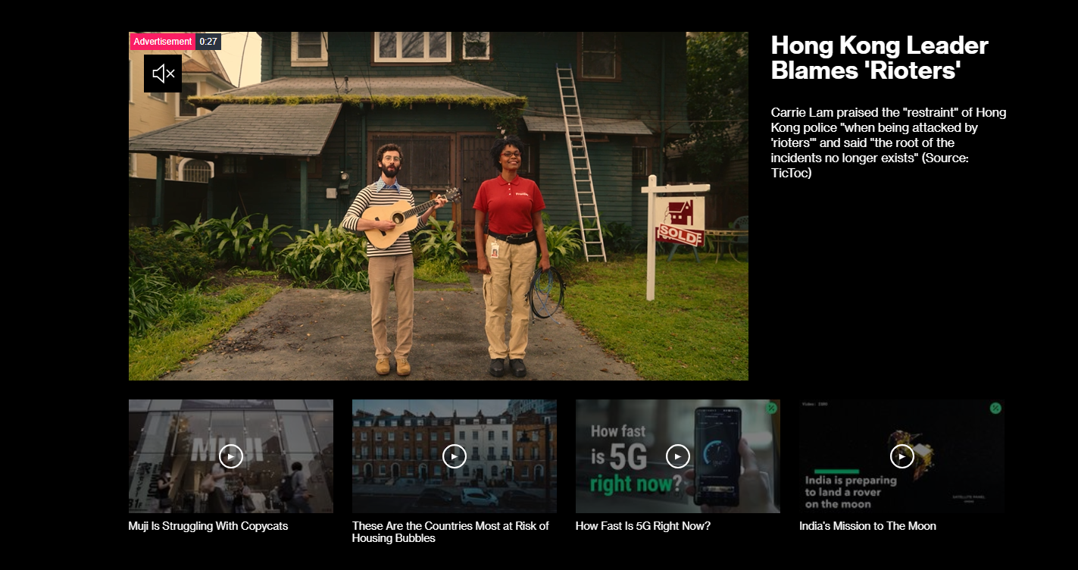
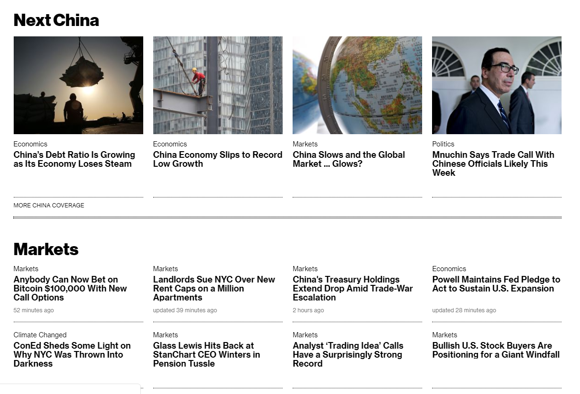
Quite Similar！

Slide 12
Some creative webpages on Bloomberg

Slide 13
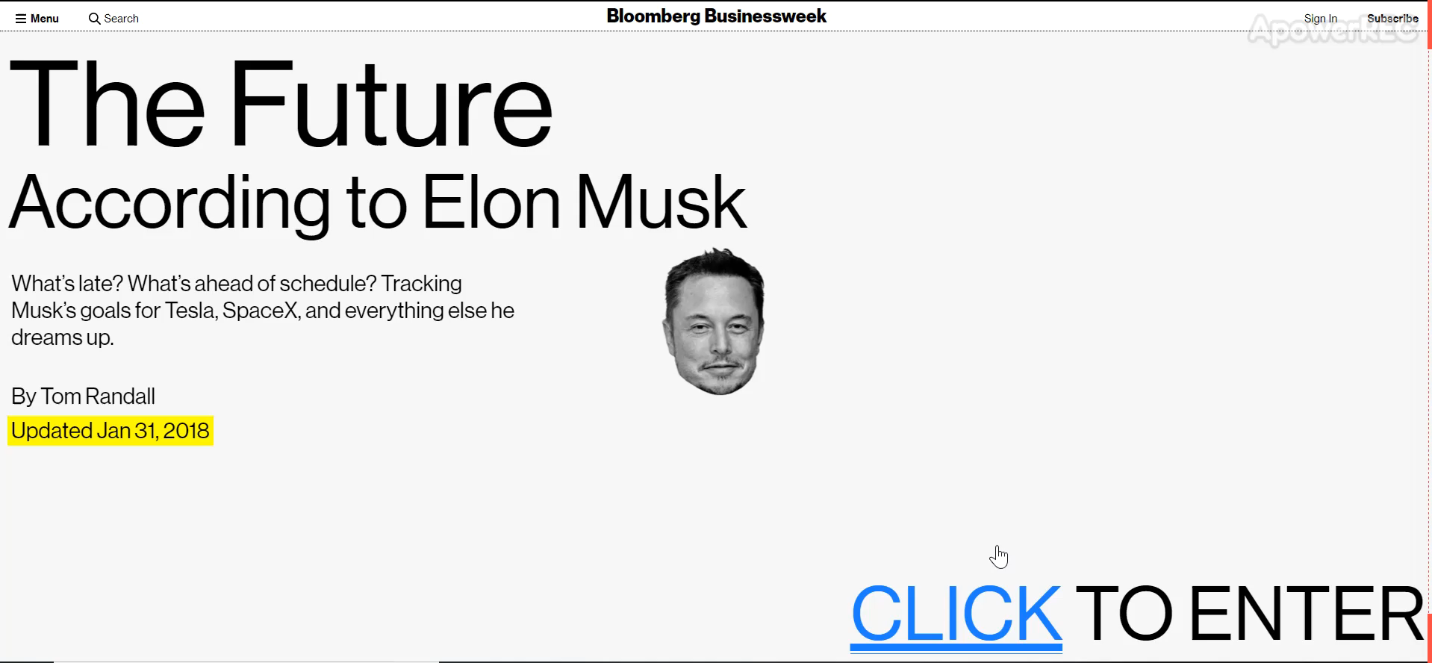

Slide 14
Comparison

Slide 15
 | Bloomberg.com | Google News
Website focus | Mainly focuses on economy news. | You can almost find everything.
layout style | Inspiration from newspaper and TV interface | Material Design
information density | Full of information | Relatively lower information desity
nature of the institution | Paid subscription | Free to public
news source | Contents creator | Contents aggregator
 | Run by Bloomberg L.P. | Run by Google
 | A mass media | An algorithm-driven internet service
Website History | Dates back to 1996 | Started in 2002

